Slide 1
Bloom Scenarios
Freshwater blooms introduced to estuary –
e.g., Microcystis aeruginosa, toxic filamentous spp.
Marine blooms in the estuary –
e.g., Akashiwo, Skeletonema
Marine nearshore blooms –
e.g., Karenia, centric diatoms

Slide 2
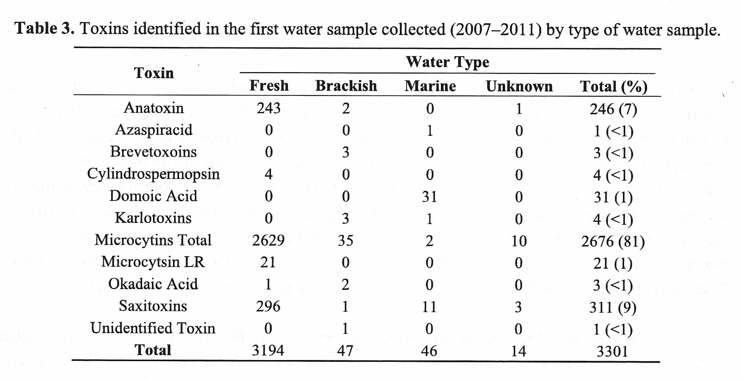
National Center for Environmental Health – HABISS Survey
Backer et al. 2015

Slide 3
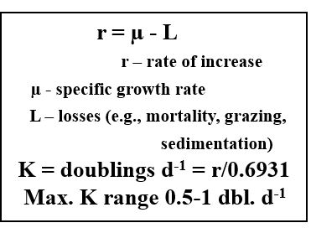

Slide 4
Drivers of Biomass - Microcystis aeruginosa
Gain Factors - Nitrogen, possibly N & P co-limitation
Temperature, e.g., Q₁₀
Light, e.g., shelf-shading, photoinhibition
I_{c}, I_{k}, D_{cr}
Water residence time/water age
Physiological condition of cells
Salinity, e.g., oligohaline conditions (<5 psu), growth potential
lower mesohaline (5-10 psu), survival, low/no growth
Loss Factors - Senescence, encystment, sedimentation
Disease – viral and bacterial
Grazing – benthic and pelagic
Dilution – Tributary inputs, tidal mixing
Salinity above 10 psu, degradation, rate dependent on colony size, physiol. Condition
Photodegradation - Biodegradation
Chemical degradation – e.g., peroxides, algicides

Slide 5
Microcystis Bloom and Toxin Fate
Minimize exposure to
harmful levels of
Microcystis and microcystin

Slide 7
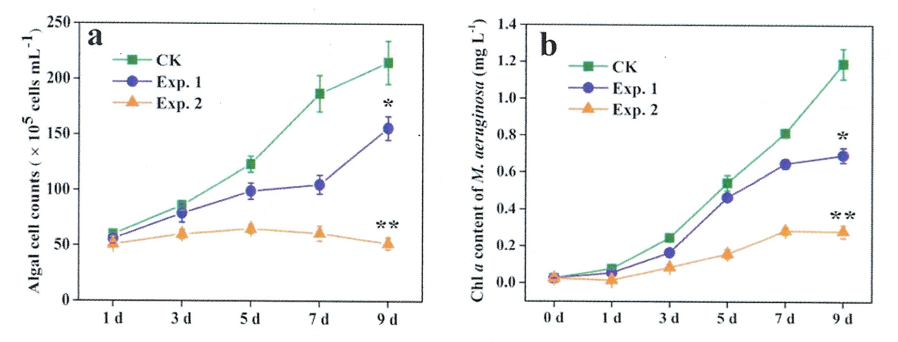
Microcystis aeruginosa – Growth x Salinity (Wang et al. 2021)
0 psu
5 psu
10 psu

Slide 8
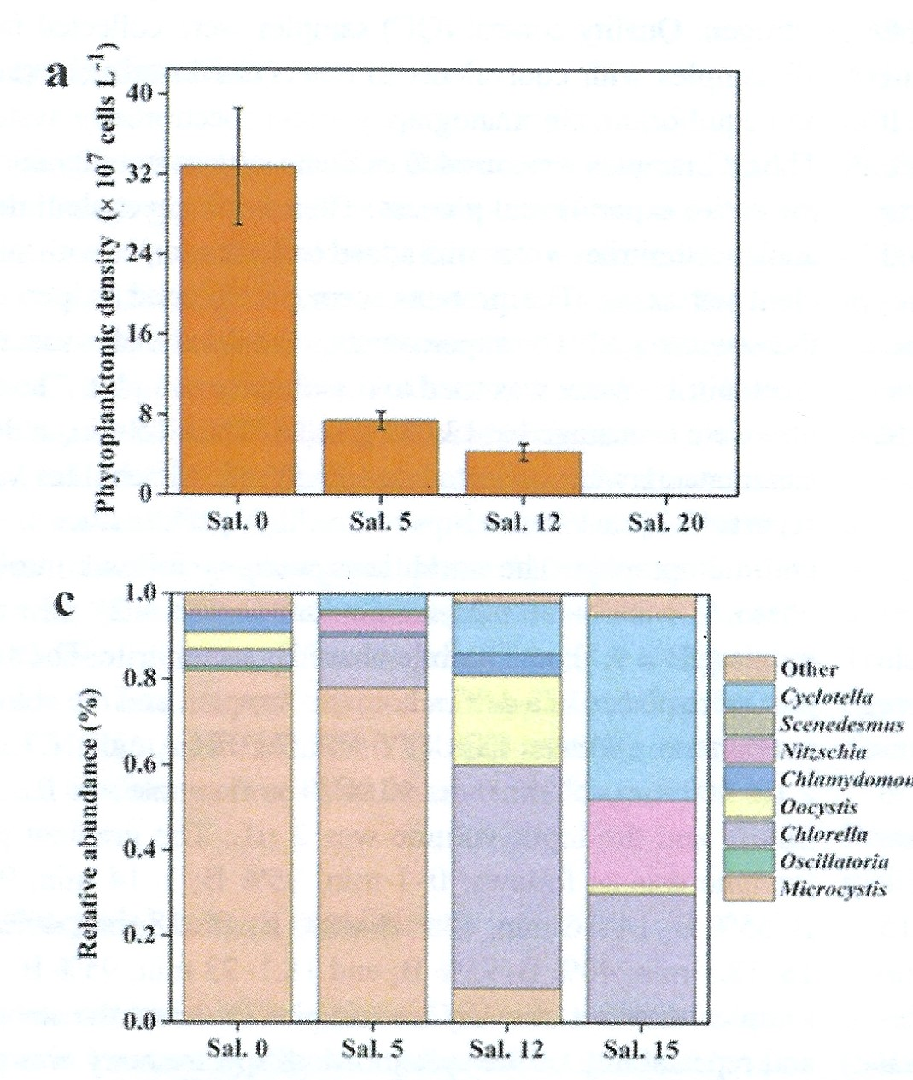
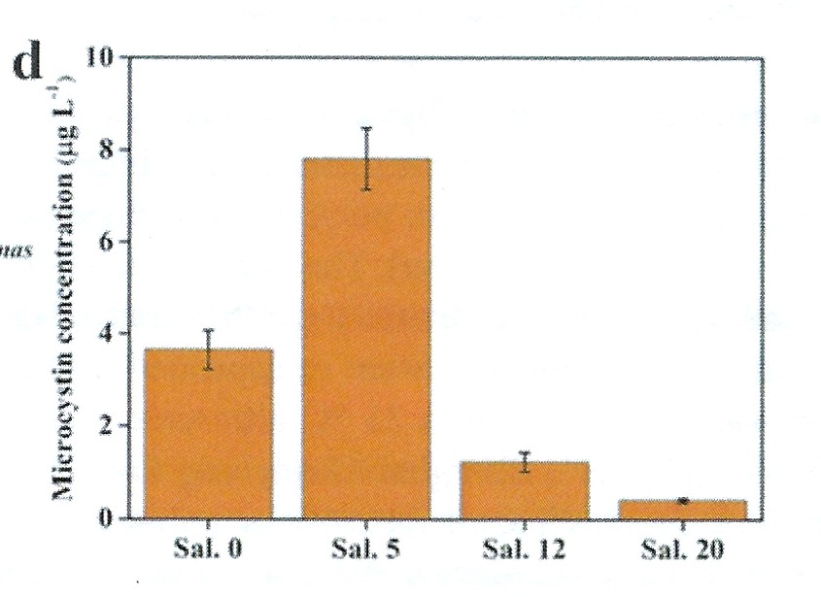
Microcystis aeruginosa Bloom – In situ biomass x Salinity
Yuniao River, China
Phytoplankton Abundance
Extracellular Toxin
Wang et al. 2021

Slide 9
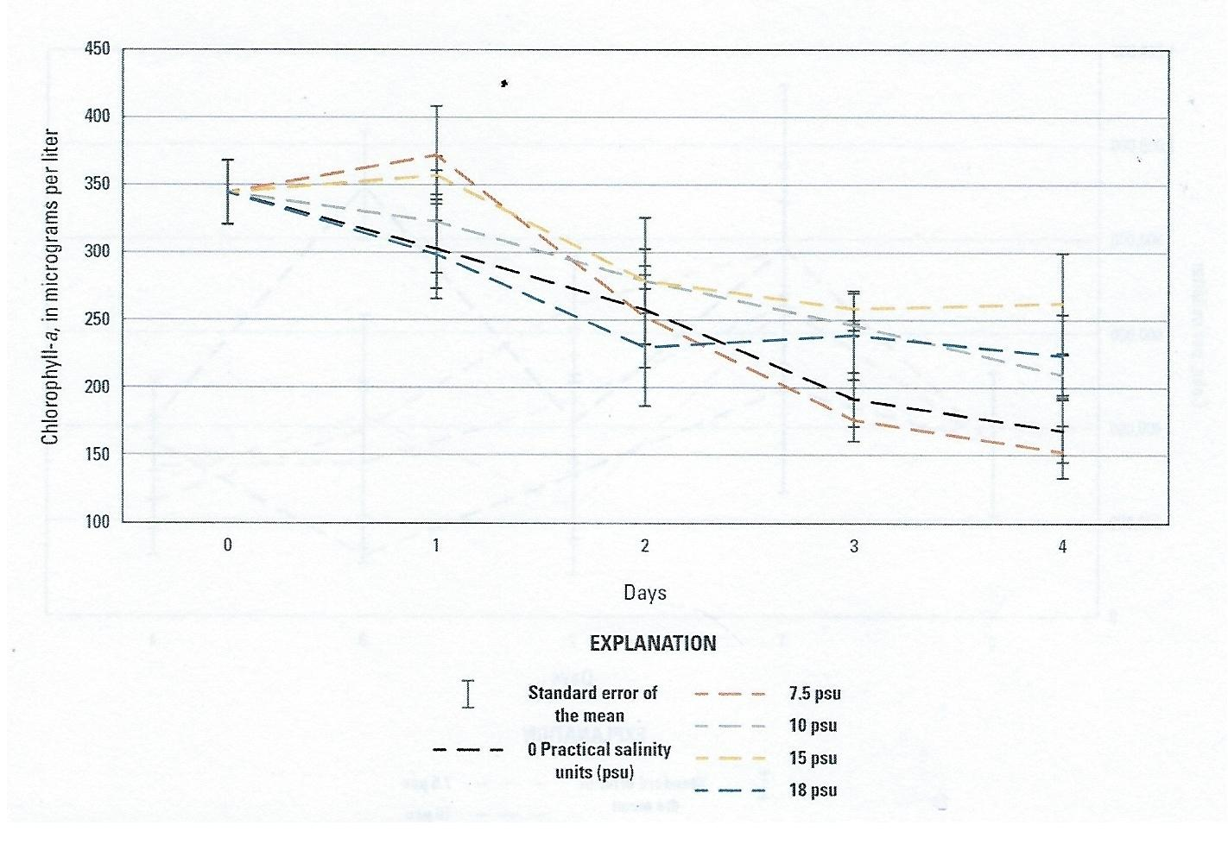
Microcystis aeruginosa – Chl a x Salinity
Rosen et al. 2018
Rosen et al. 2018

Slide 10
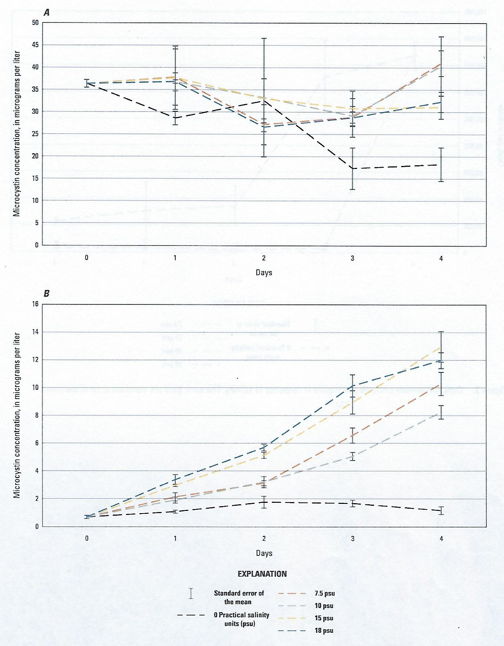
Total Toxin
Microcystin x Salinity
Extracellular Toxin
Rosen et al. 2018

Slide 11
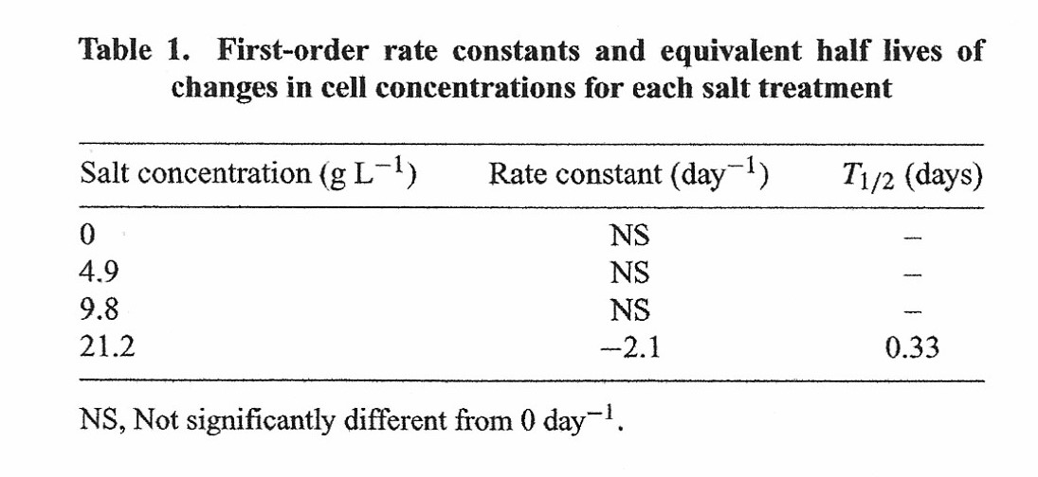
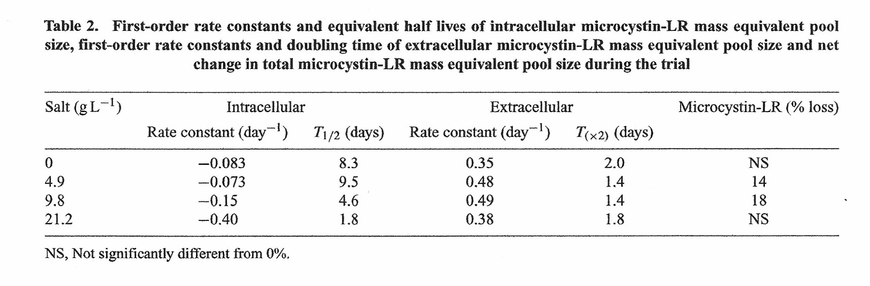
Short-term Dynamics – 24 hour
Orr et al. 2004

Slide 12
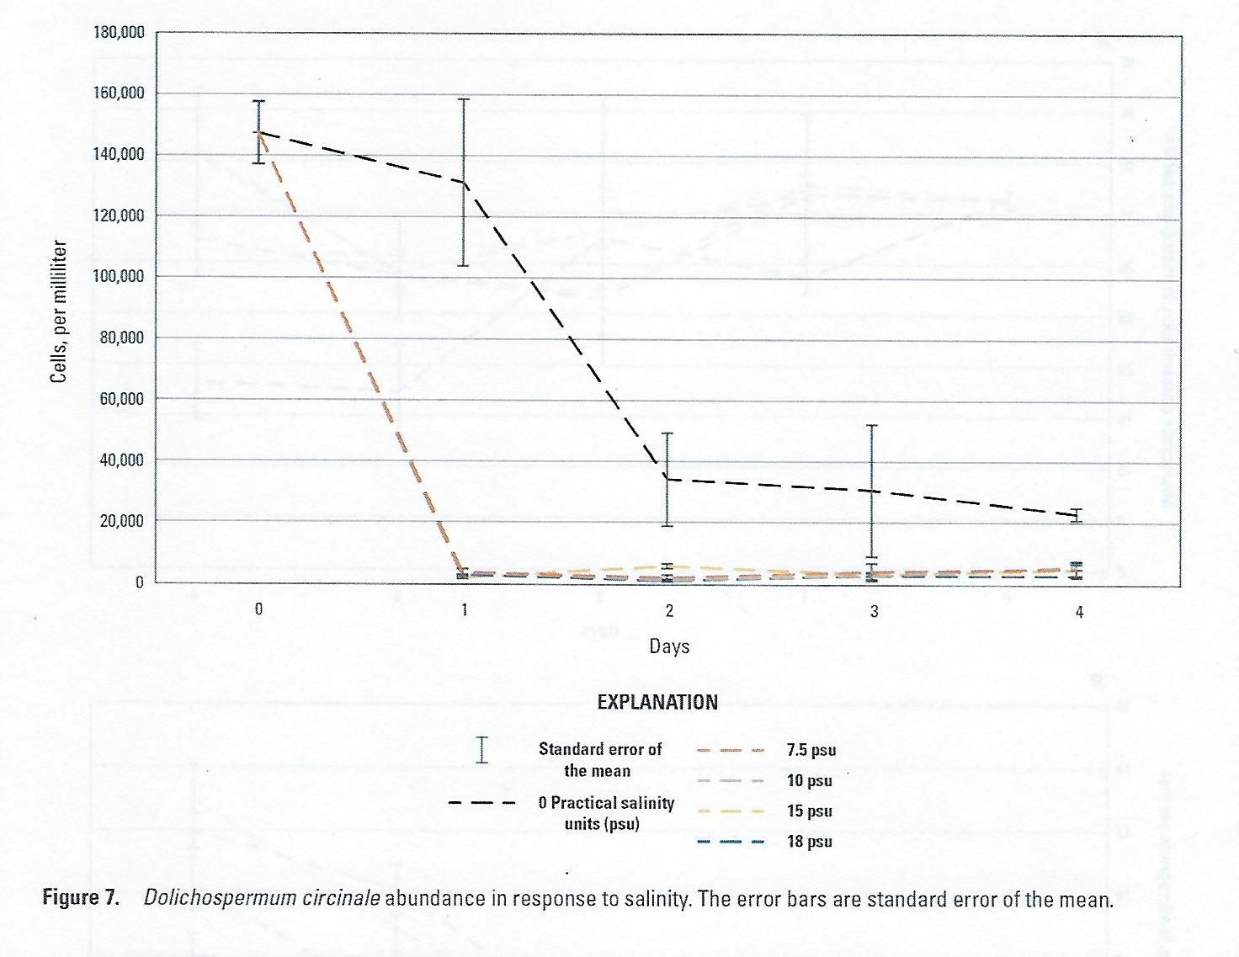
Dolichospermum – Chl a x Salinity
Rosen et al. 2018

Slide 13
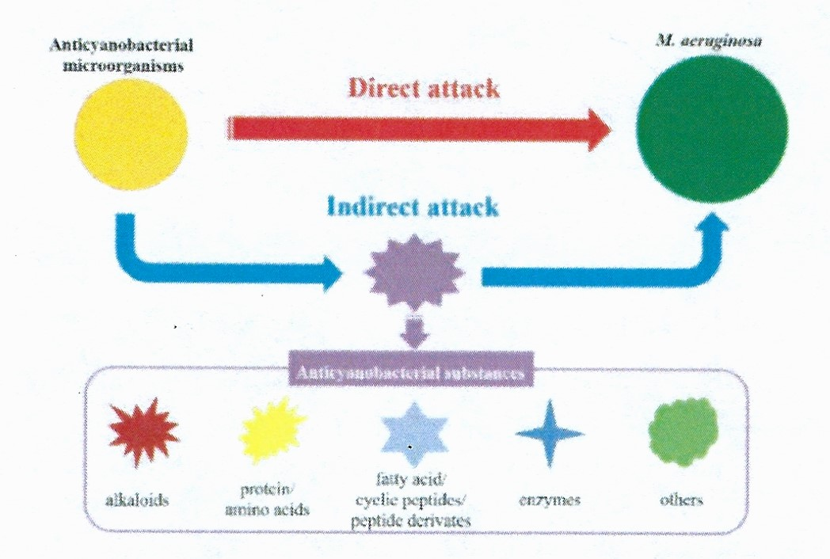
Biodegradation of Microcystin
Kong et al. 2022

Slide 14
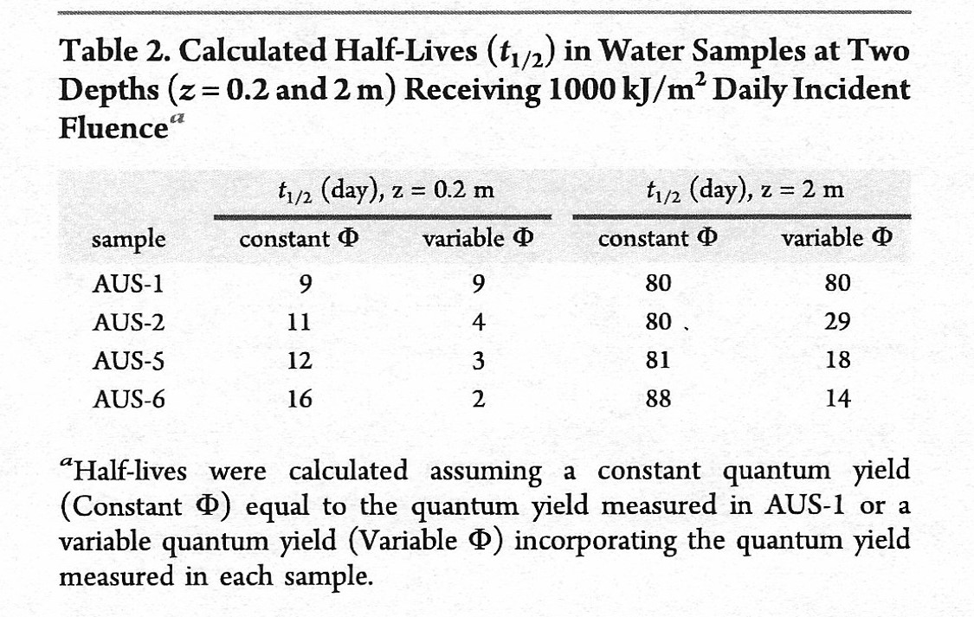
Microcystin Photodegradation
Constant – Salinity low based on AUS-1 upstream location
Variable – Salinity effect based on increasing salt AUS-1 to AUS-6
Parker et al. 2016

Slide 15
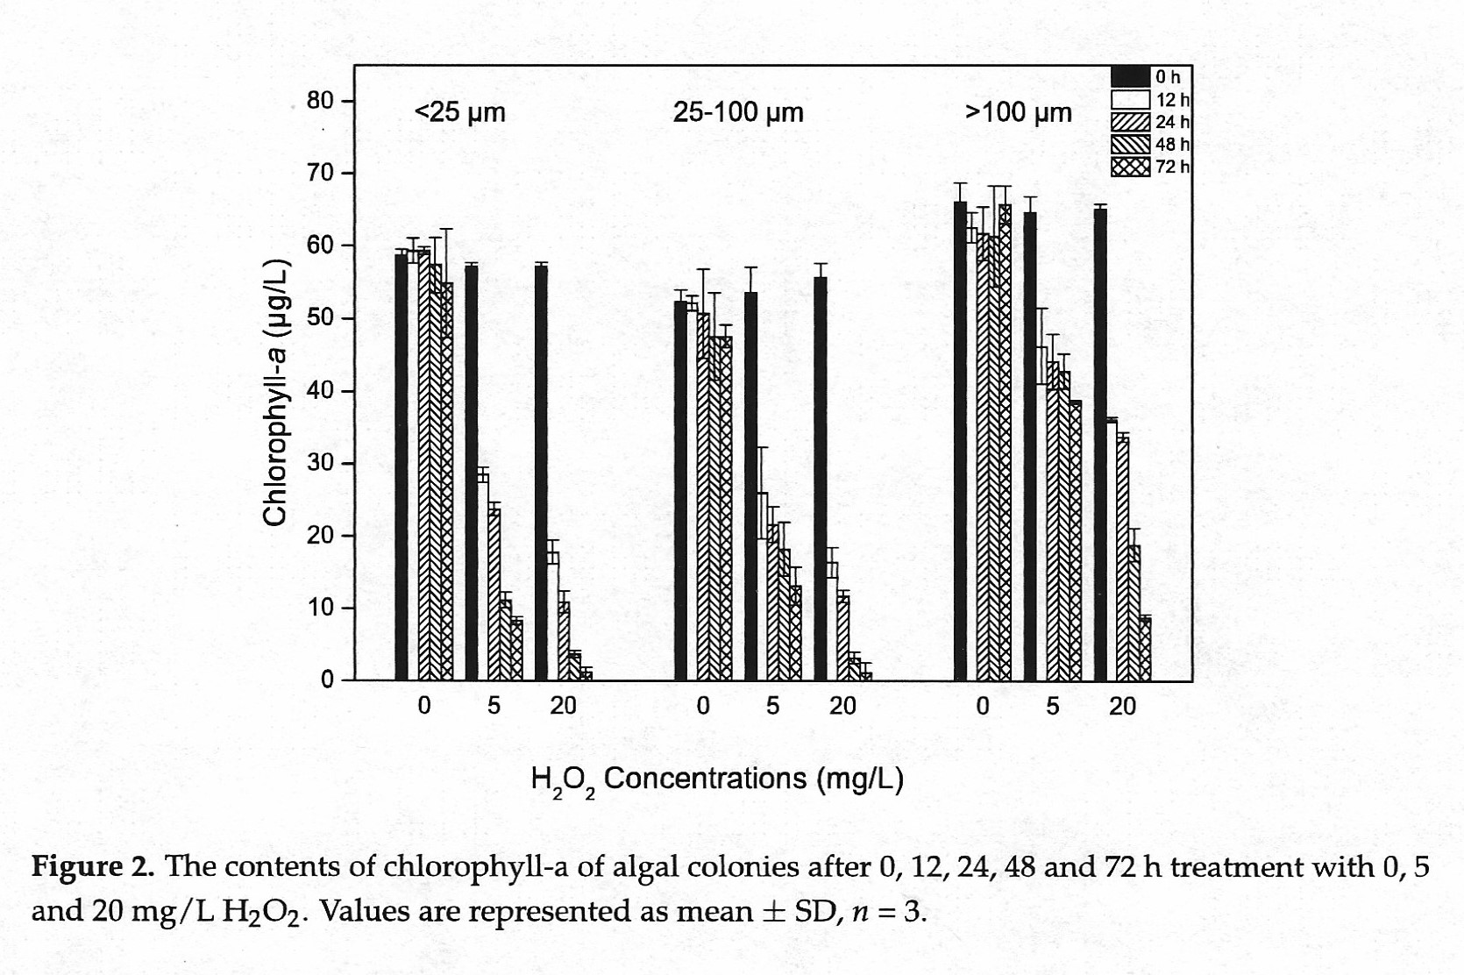
Effect of Peroxide Treatment
Liu et al. 2017

Slide 16
Issues
Hypoxia – e.g. faunal mortalities, nutrient dynamics
Toxins – e.g. neurotoxins, hepatotoxins, ichthyotoxins
Allellopathy – e.g. elimination of beneficial taxa
Light attenuation – e.g. loss of seagrass production
Physical disruption – e.g. muscilage, spines
Food web alteration – e.g. carbon transfer, microbial loop
Aesthetics –
Public
Outrage

